Slide 1



Slide 2
Meet the Committee
President – Muneeb Chughtai
Vice President – Ahmiada Busheha
Head of Events – Sakina Khaki
Head of Marketing – Joseph Field
Community Manager – Sameer Mahmood
Treasurer – Layba Saleem
Chief of Staff – Hafsa Sabed
Executive Team

Slide 3
Meet the Committee
Head of Finance – Layba Saleem
Industrial Liaison – Summer Ali
Industrial Liaison – Yasin Shawkhawat
Finance Team

Slide 4
Meet the Committee
Events Team
Head of Events – Sakina Khaki
Social Lead – Yusaf Sajid
Cyber Lead – Mahdi Egal
Games Lead – Erick Vilcica

Slide 5
Meet the Committee
Head of Marketing – Joseph Field
Website Developers
Ben Snaith
Kunal Kunal
Marketing Coordinators
Basanta Kandel
Musa Ahmed
Harry Clark
Manahil Firdous
Marketing Team

Slide 6
Why Join?
Social Sessions
Technical Sessions
Internships and Placement support
Academic Support
Aston Hack
Cybersecurity Hackathon

Slide 7
Sessions
Social
Interact with your course mates
Technical
Build up your knowledge and skills.

Slide 8
Hackathons
Computer Science Hackathon
Show your coding skills to a panel of judges.
February 2026
Win prizes for top contestants
Aston Hack

Slide 9
Hackathons
Cybersecurity Hackathon
A new event featuring CTF challenges
November 2025
Win Prizes for top teams
Cyber Hack

Slide 10


Fun Facts about US
Sponsored by the
Majestic & School of
Computer Science in 24/25
£1000 fundraised in 24/25.
The membership is only £5 for the year.
AstonHack sold out for the first time ever.
180 attendees in 24/25, from 23/24’s 120.
Held 17 Social Events & 15 Technical Events
In 24/25

Slide 11
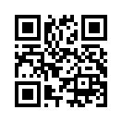
Check out our Socials!
astoncss.com/join
Join our society!

Slide 12
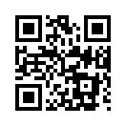
Check out our Socials!
Astoncss.com/WhatsApp
Whatsapp CHAT

Slide 13
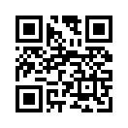
Check out our Socials!
Discord.gg/acss
Discord
Server

Slide 14
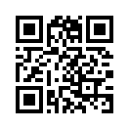
Check out our Socials!
@astoncss
Instagram
PAGE

Slide 15
Check out our Socials!
mc.astoncss.com
Minecraft
Server
JAVA & BEDROCK DEFAULT PORTS Java: 25565 bedrock: 19132

Slide 16
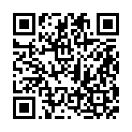
Check out our Socials!
Aston Computer Science Society
LinkedIn
PAGE

